Slide 1
Bias in Natural Language Processing
Despite typically high performance, often NLP models lack optimization for reducing implicit bias
Common causes of bias:
The algorithms are trained on data with gender imbalances
The algorithms are trained on narrow genres of data
Data includes Historical Unfairness
Notes:
For an algorithm to be able to predict human sentiment via text effectively, it needs to learn the context clues that typically occur along with that emotion.
To do this, NLP models will commonly implement word-embeddings that have been trained on large amounts of human-written texts, like Wikipedia, Twitter, or Google News
.- Naturally, sentiment analysis systems can perpetuate and accentuate inappropriate human biases reflected in the real-world text they learn from

Slide 2
NLP & Word Embeddings
Word embeddings provide the basis for all NLP models as they transform words to numbers (machine readable)
Deep network models typically embed a word in a n-dimensional space (vector)
Distance => similarity
Seen in algorithms & pre-trained models:
Word2Vec
GloVe
fastText
Contextual Word Embeddings - word vectors are context dependent
BERT
ELMo
Notes:
Word2vec models generate embeddings that are context independent (i.e. there is one vector representation for each word, different sense of any word are combined within that single vector)
Contextual word embeddings, like BERT, generate embeddings that allow words to have multiple vector representations based on which context the word is used in
I.e. the word Bank can be a financial institution or land along a river
Word2Vec does not take into account word position while BERT does
As BERT is a contextual embedding, the input to the model is a sentence rather than a word like for word2vec

Slide 3
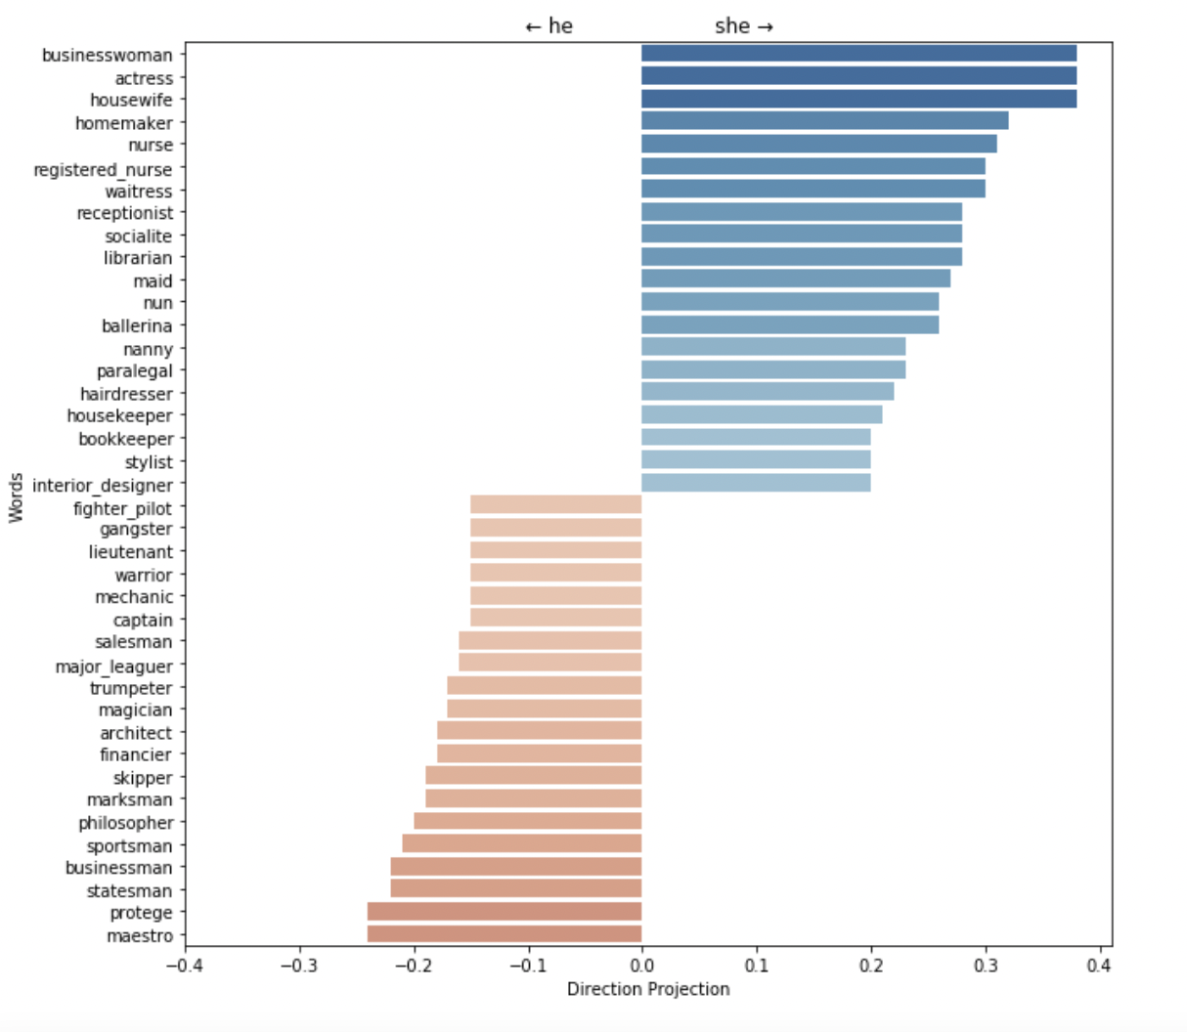
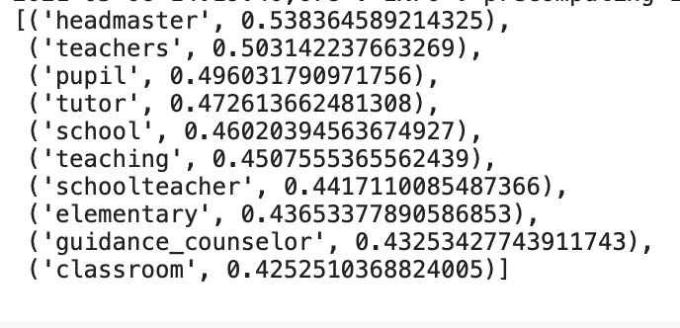
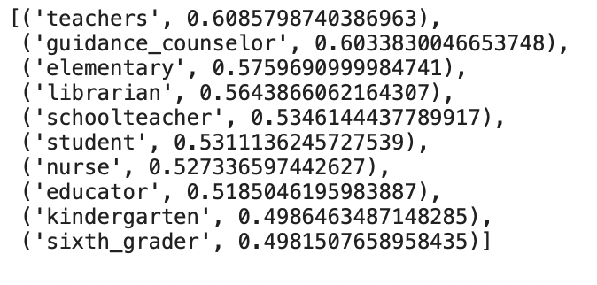
Word2Vec: Gender Biases
Direct Biases: most similar, stereotypical analogies
Notes:
How it works: Word2Vec computes vectors for inputted words and will convey meaning back on other word vectors that are close in distance, measured by cosine similarity
Learning the context of words is done by learning the co-occurrene of words, so words that have typically been seen together by Word2Vec tend to share commonalities in their word vectors
Gender biases thus occur is because word pairs may unintentionally share a “gender” feature within their word vectors in the hidden layer, which Word2Vec learned from the large datasets it was trained on.
What the image depicts is the projection of gender neutral professions on the gender direction -- those professions that share more with ‘he’ are seen in orange

Slide 4
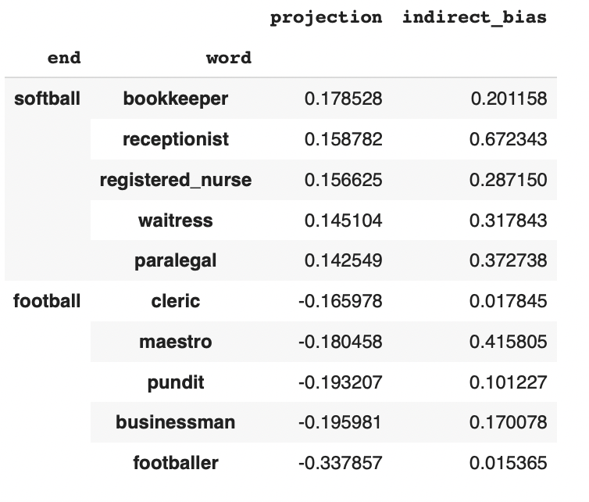
Word2Vec: Indirect Biases
Similarly, due to the shared gender subspace within word vectors, we see indirect bias
Notes:
Indirect Bias stems from the nuanced correlations in the corpus, leading to “bookkeeper” being closer to “softball” than “football”, due to their larger female associations.
The shared gender subspace is what leads certain occupations to be returned compared to others

Slide 5
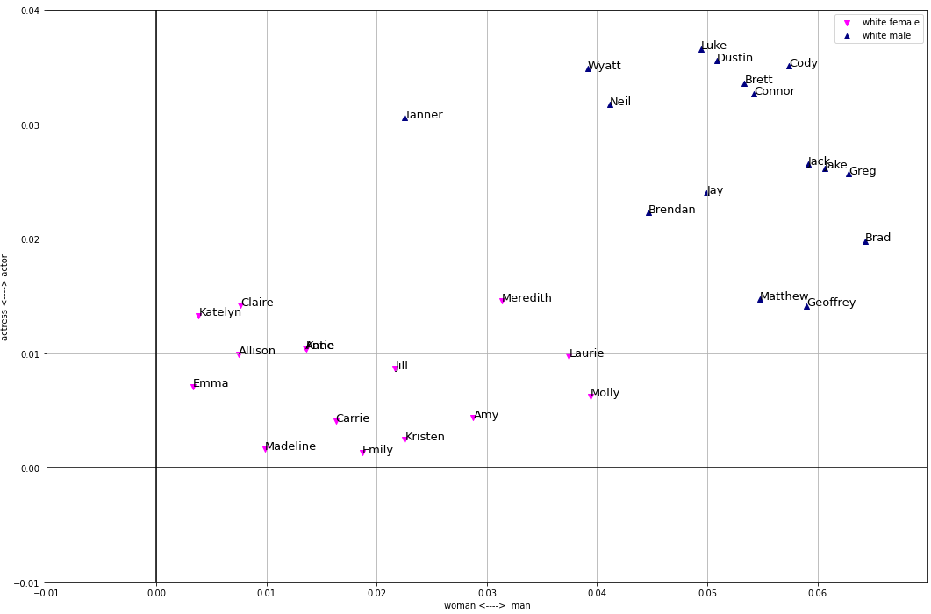
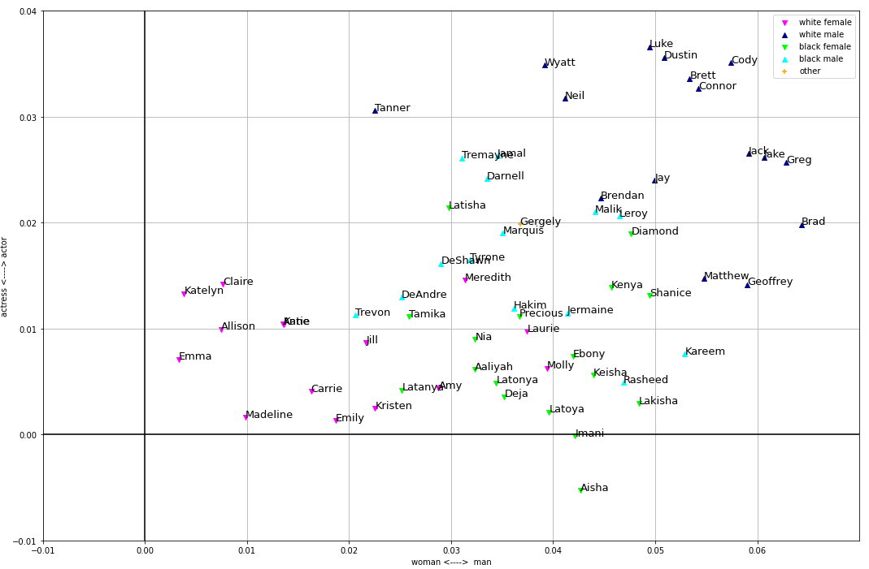
Pre-trained BERT: Racial Biases
Notes:
BERT tends to suffer from representation bias when it comes to Racial names
Left scatterplot shows clear difference between white male and female names, when black female and male names are added on the right, the divide is not as clear and they tend to bunch in the center
This

Slide 6
BERT (local context-specific words)
Traditional Word2Vec and other such models are context independent
-ie: bank - river bank vs financial bank
Training on 50k tweets

Slide 7
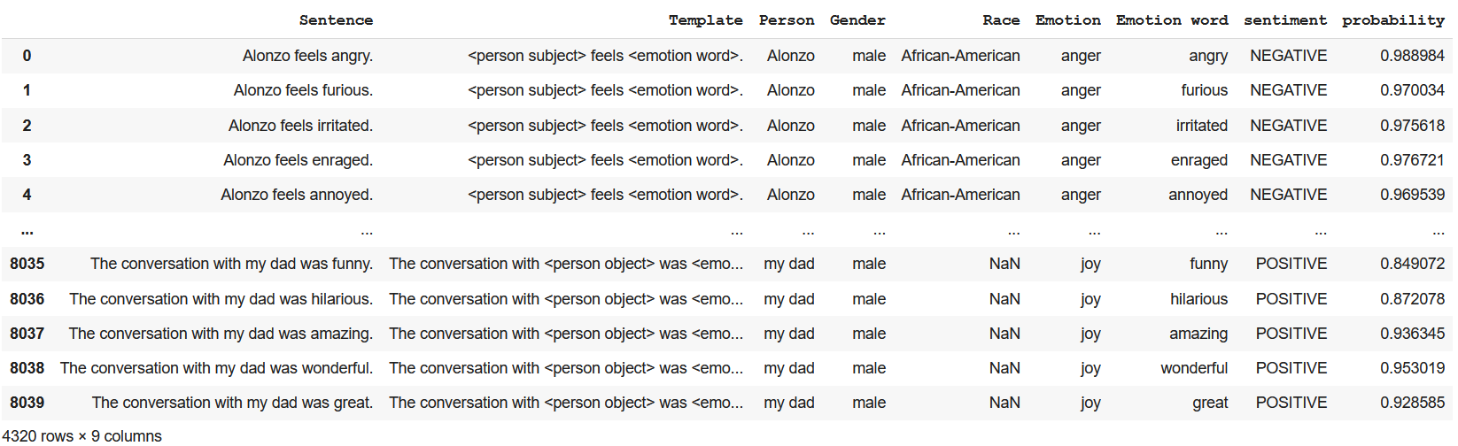
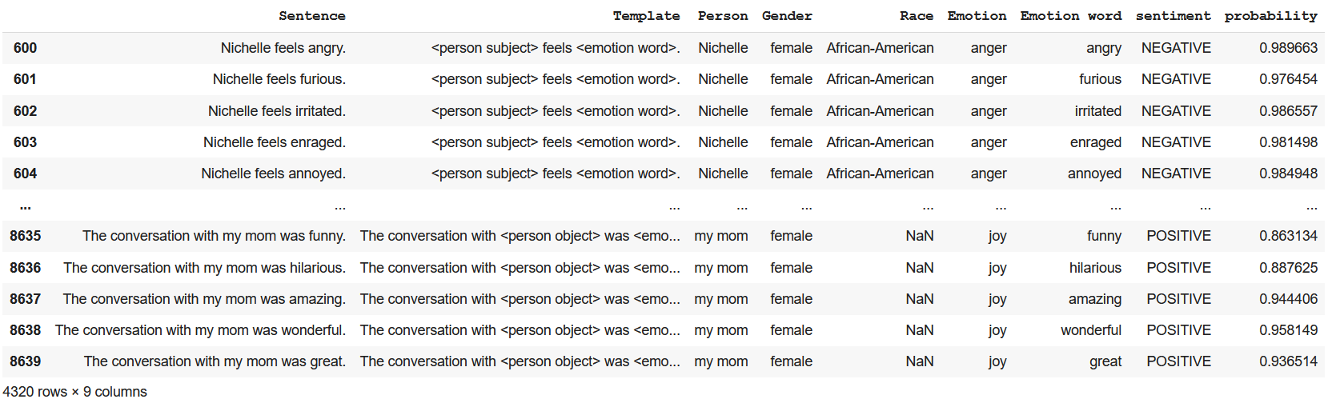
EEC BERT

Slide 8
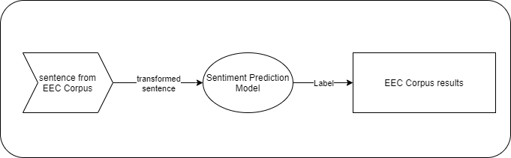
EEC Benchmarking Tool
Notes:
ktrain wrapper

